Slide 1
LAXATIVES AND PURGATIVES PHA 304 Lecture
BY
Pharm F.A OLADOJA.
B.Pharm, M.Sc., ACISM(USA), ACIWM, PGD, ACA
Department of Pharmacology and Toxicology,
Faculty of Pharmacy,
Olabisi Onabanjo University.

Slide 2
DEFINITIONS
Purgatives & laxatives are drugs that promote evacuation of bowels, used in constipation and dyschezia.
Constipation : Delayed passage of faeces through the intestine.
Dyschezia: Derangement of defaecation process due to 1. Pain arising from haemorrhoids or fissure 2. Presence of hard dehydrated faecal matter in the rectum

Slide 3
Constipation
Abnormally infrequent and difficult passage of feces through the lower GI tract
Symptom, not a disease
Disorder of movement through the colon and/or rectum
Can be caused by a variety of diseases or drugs

Slide 4
BACKGROUND
Purgative: Stronger action resulting in more fluid evacuation
Laxative: Milder action, elimination of soft but formed stools.
Aperients (to get rid off) < Laxatives (to loosen) < Emolient (to smooth and soften) < Evacuant (to empty) < Purgatives (to clean)< Cathartic (to utterly clean)

Slide 5
DRUG CLASSIFICATION
1. Bulk forming Dietary fibre: Bran*, Psyllium, Ispaghula, Methylcellulose
2. Stool softener Docusates (DOSS)*, Liquid paraffin*
3. Stimulant (irritant) laxative/purgatives (a) Diphenylmethanes Phenolphthalein, Bisacodyl*, Sodium picosulfate
(b) Anthraquinones (Emodins) Senna, Cascara sagrada (c) 5-HT4 agonist: Prucalopride (d) Fixed oil: Castor oil
4. Osmotic laxative/purgatives: Magnesium and sodium salts, Lactulose etc

Slide 6
CASE STUDY: Laxatives/ Purgatives
•Mr Bamidele, A 55year old factory worker is suffering from Tape worm infestation is on Niclosamide. Which drug should be combined along with it? •Mr. Tobi who is a post MI patient is suffering from constipation….which drug should you give ?
At the end of this lecture you should all be able to address these questions confidently

Slide 7
.
LAXATIVES

Slide 8
LAXATIVES
Laxatives are used
1) To treat constipation
2) To avoid undue straining at defaecation in cases having hernia,
haemorrhoids or cardiovascular disease
3) Before or after surgery of any anorectal disease
4) In bedridden patients

Slide 9
Laxatives: Mechanism of Action
Bulk forming
High fiber
Absorbs water to increase bulk
Distends bowel to initiate reflex bowel activity
Examples:
psyllium (Metamucil)
methylcellulose (Citrucel)
Polycarbophil (FiberCon)
Wheat bran
Ispaghula

Slide 10
Bulk forming laxatives
Indigestible, hydrophilic substances like bran, agar, methylcellulose, ispaghula etc.
Absorb water, swell up and increase the bulk of stools.
Cause mechanical distension so stimulate peristalsis and promote defecation.
Large amount of water should be taken with bulk laxatives to avoid intestinal obstruction.
Potential for drug interactions (digoxin, warfarin, salicylates, ciprofloxacin)
AEs: flatulence, abdominal pain, GI obstruction

Slide 11
Bulk-Forming Laxatives: WHEAT BRAN
Wheat bran consists of 40% dietary fibre
It absorbs water in the intestines, swells, increases water content of faeces
Stimulate local peristalsis & defecation reflexes by increasing faecal bulk
Dose : 20-40 g/ day, acts 1-3 days S/E : Bloating C/I : GIT ulcerations, adhesions, stenosis

Slide 12
Surfactant Laxatives: STOOL SOFTENER
Dioctyl sodium sulfosuccinate(Docusate)
It is an anionic detergent which softens the stool by decreasing the surface tension of fluids in the bowel.
It also acts as a wetting agent for the bowel, because by emulsifying the colonic contents it facilitates the penetration of water into faeces

Slide 13
Surfactant Laxatives: STOOL SOFTENER
Dosage : 100-400 mg/day.
Indicated when straining at defaecation is to be avoided
Side Effects:
Bitter in taste, Nausea, Cramps and abdominal pain.
Prolonged use leads to Hepatotoxicity

Slide 14
Emollient Laxatives
MOA
Surfactant agents that facilitate mixing of aqueous and fatty materials within the GI tract which increases stool moisture content and leads to a softer, easier to pass stool
Agents
Docusate sodium (Colace)
Docusate calcium (Surfak, others)
Place in therapy
Ineffective in treating constipation but are used to primarily to prevent constipation
Also useful in situations where straining to pass stool should be avoided (e.g. recovery from myocardial infarction, acute perianal disease, recovery from rectal surgery, etc.)

Slide 15
Lubricant Laxatives
Pharmacologically inert mineral, not palatable, but can be given in emulsified form or with juices.
Liquid paraffin Dose : 15-30 ml/ hs. Latency period: l-3 days
Side Effects
It is not palatable
Frequent use leads to the deficiency of fat soluble vitamins

Slide 16
PURGATIVES
Purgatives are used for complete colonic cleansing
1. Prior to gastrointestinal endoscopic procedure
2. To flush out worms after the use of an anthelmintic drug
3. To prepare the bowel before surgery or abdominal X-ray
4. Food/Drug poisoning
5. For post operative or post-Ml bedridden patient

Slide 17
Purgatives
Purgatives: Osmotic and irritant Purgatives
I. Osmotic Purgatives: a) Saline purgatives : Magnesium sulfate, Magnesium hydroxide, sodium sulfate, sodium phosphate etc
b) Electrolyte osmotic purgative: Polyethylene glycol (PEG)-

Slide 18
Saline Purgatives
Mode of Action:
Increase osmotic pressure within the intestinal tract, causing more water to enter the intestines
Result: bowel distention, increased peristalsis, and evacuation
Examples: magnesium sulfate (Epsom salts) magnesium hydroxide (MOM) magnesium citrate, sodium phosphate (Fleet Phospho-Soda)
Doses : Mag. Sulfate : 5-15 g. Mag. Hydroxide: 30 ml.
Dissolved in 200 ml of water & effects come with in 2-3 hrs

Slide 19
Osmotic/saline
Most powerful and rapid acting.
Salts of magnesium, sodium or potassium.
Given orally, not absorbed from gut, remain in lumen and exert osmotic effect, draw water in lumen, distend the bowel, stimulates peristalsis.
Sodium phosphate used in enema before surgery.
Should be avoided in cardiac patients.

Slide 20
Lactulose and Sorbitol
Often used in chronic constipation
Can also be used as an alternative in acute constipation or in patients with an inadequate response to increased dietary fiber and bulk-forming agents

Slide 21
Polyethylene Glycol (PEG)
Approved for treatment of constipation in low doses (17 to 34 grams per day)
It is not absorbed systemically or metabolized by colonic bacteria and hence has a lower incidence of adverse effects
17g per day is safe and effective for use for up to 6 months
PEG is a grade A recommendation from the American College of Gastroenterology for the treatment of chronic constipation
The patient may mix PEG with fruit juice, water, or milk
PEG solutions with electrolytes are used as bowel cleansing regimens prior to GI-related procedures (e.g. colonoscopy)

Slide 22
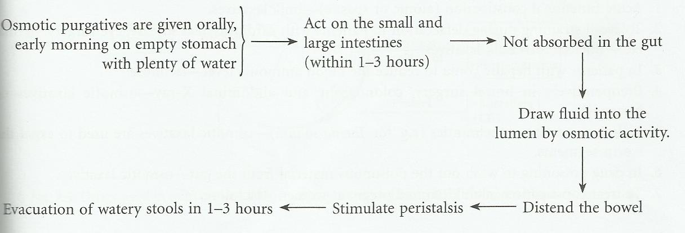
Osmotic laxatives/purgatives mechanism

Slide 23
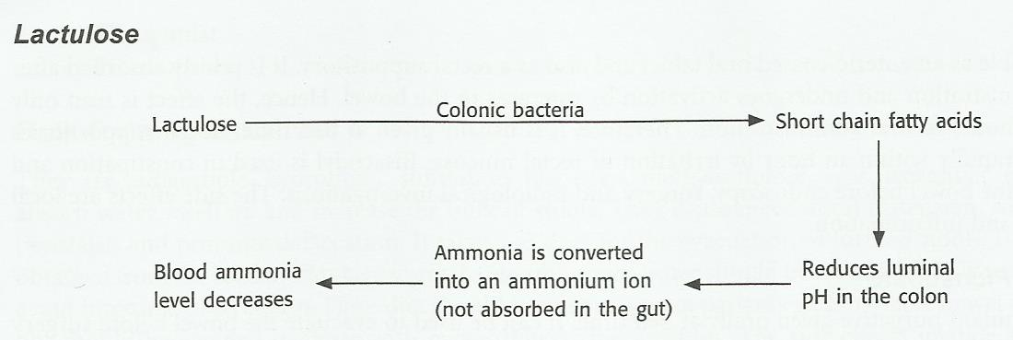
Mechanism of lactulose

Slide 24
Irritant Purgatives
Irritant Purgatives: (a) Anthraquinone group: Senna, Cascara sagrada, and Aloe.
(b) Organic irritants: Phenolphthalein, Bisacodyl, Sodium picosulfate.
(c) 5 HT4 Agonist: Prucalopride.
(d) Oils: Castor oil.

Slide 25
Irritant Purgatives
Senna, Cascara sagrada, and Aloe.
Plant purgatives contain anthraquinone glycosides [emodins]
Active principle “anthrol” which acts locally or is absorbed into circulation
Acts on the myenteric plexus to increase peristalsis and decrease segmentation
Senna Dose: 12-25 mg hs, effects come within 6-8 hours,

Slide 26
Irritant Purgatives
Side Effects:
Produce abdominal cramps & nausea
Senna glycosides are secreted through milk.
Chronic use leads to brown pigmentation of the colon known as "melanosis coli".

Slide 27
Bisacodyl
Activated in the intestine by deacetylation
In the colon it irritate the mucosa, produce mild inflammation and secretion
Oral Dose : 5-10 mg hs. The effect appears with in 8-10 hrs. Suppositories act with in 20-40 mins
Side Effects: Abdominal cramps and skin rashes. Higher doses can cause mucosal damage

Slide 28
Stimulant Laxatives (summary)
MOA
Stimulate the mucosal nerve plexus of the colon causing peristalsis
Expected to cause a bowel movement within 8 to 12 hours of administration
Agents
Bisacodyl administered orally (Ducolax, Correctol, others)
Senna (Senokot, others)
Place in therapy
Not recommended as first-line therapy
Reserved for intermittent use or in patients who fail to respond to bulk-forming or osmotic agents

Slide 29
Miscellaneous Agents
Lubiprostone (Amitiza)
Linaclotide (Linzess)
Naloxegol (Movantik)

Slide 30
Lubiprostone
MOA
A chloride channel activator that acts locally on the apical membrane of the GI tract to increase intestinal fluid secretion and improve fecal transit
Indications and dose
Chronic idiopathic constipation (24mcg twice a day)
Constipation-predominant irritable bowel syndrome (24mcg twice a day)
Opioid-induced constipation (8mcg twice a day)

Slide 31
Lubiprostone
Safe and effective for long-term treatment (up to 48 weeks)
Most patients have a bowel movement within 24 to 48 hours of administration
Due to expense and lack of comparative data, it is reserved for patients with chronic constipation that fail conventional first-line agents
Adverse effects
Nausea, headache, diarrhea, abdominal distention
Patient counseling
Educate on adverse effects
Instruct patients to take with food and water to reduce nausea

Slide 32
Linaclotide
MOA
Binds to and agonizes guanylate cyclase-C on the luminal surface of the intestinal epithelium which results in increased cGMP concentrations which causes increased chloride and bicarbonate secretion into the intestinal lumen resulting in increased intestinal fluid and decreased GI transit time
Indications and dose
Chronic idiopathic constipation (72mcg or 145 mcg once a day)
Constipation-predominant irritable bowel syndrome (290mcg once a day)

Slide 33
Naloxegol
MOA
A mu-opioid antagonist
Composed of naloxone conjugated with a polyethylene glycol polymer, which limits its ability to cross the blood-brain barrier
Functions peripherally in the GI tract to decrease constipation associated with opioids
Indications and dose
Opioid-induced constipation (25mg once a day; if not tolerated, may decrease to 12.5 once a day)

Slide 34
Naloxegol
Adverse effects
Abdominal pain, flatulence, nausea, vomiting, headache, excessive sweating
Patient counseling
Discontinue all maintenance laxative therapy prior to use
May reintroduce laxatives as needed if suboptimal response to naloxegol after 3 days
Take on an empty stomach at least 1 hour before or 2 hours after the first meal of the day
Avoid grapefruit products
Discontinue treatment if opioid pain medication is discontinued

Slide 35
Prokinetic Agents
Metoclopramide & erythromycin work on the upper GI tract to promote peristalsis
Little benefit for constipation
Tegaserod was approved for chronic constipation in persons <65 years old, but voluntarily suspended from market by the manufacturer in March 2007 after a pooled analysis of 29 placebo-controlled short-term trials found a statistically significant increase in cardiovascular ischemic events, including heart attack, angina, and stroke
.

Slide 36
Choice of Drugs /Uses
Functional Constipation 1. Spastic constipation
Dietary fibre
Bulk forming agents taken over weeks.
Stimulant purgatives are contraindicated.
2. Atonic constipation (sluggish bowel):
Due to old age, debility or laxative abuse
Bulk forming agent, Bisacodyl or senna given once or twice a week

Slide 37
Choice of Drugs /Uses
Bedridden patients (MI, stroke, fractures, postoperative):
Prevent constipation- Bulk forming, docusates, lactulose, liquid paraffin.
To avoid straining at stools (hernia, cardiovascular disease, eye surgery) and in perianal afflictions (piles, fissure, anal surgery)
Bulk forming agents, Docusates, lactulose and liquid paraffin.

Slide 38
Choice of Drugs /Uses
Preparation of bowel for surgery, colonoscopy, abdominal X-ray Saline purgative, bisacodyl or senna
After anthelmintics: Saline purgative or senna
Food/ drug poisoning: Saline purgatives

Slide 39
Drugs that can cause constipation
• Opioids
• Anticholinergics
• Antiparkinsonian,
• Antidepressants and Antihistaminics
• Almunium and Calcium groups of antacids
Oral iron, clonidine, verapamil

Slide 40
SIX(6) TAKE HOME POINTS
All laxatives can cause electrolyte imbalances
Patients should not take a laxative or cathartic if they are experiencing nausea, vomiting, and/or abdominal pain
A healthy, high-fiber diet and increased fluid intake should be encouraged as an alternative to laxative use
Long-term use of laxatives often results in decreased bowel tone and may lead to dependency
Patients should take all laxative tablets with 6 to 8 ounces of water
Bisacodyl and cascara sagrada should be given with water due to interactions with milk, antacids, and H₂ blockers

Slide 41
Questions?

Slide 42

.

